Slide 1
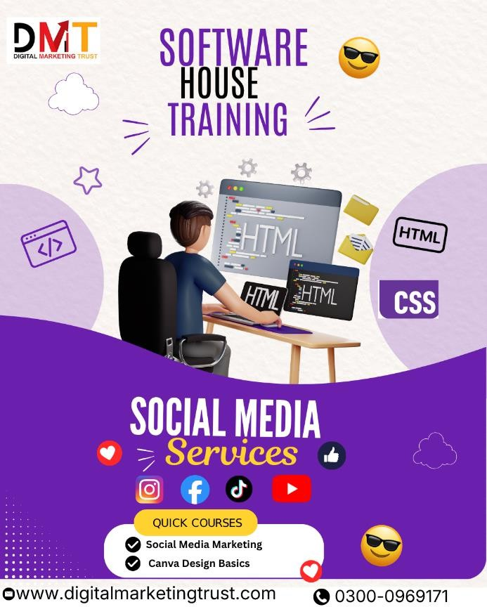
Social Media Marketing Services in Pakistan
What is Social Media Marketing?
. Only with this understanding can your brand create meaningful content, enabling your business
What is Social Marketing — The New Word-of-Mouth Marketing
For centuries, word-of-mouth marketing has been one of the most influential marketing tools. In the 21st century, word-of-mouth marketing has taken a new form – online social media.
As a marketer, social networking sites like Facebook, Twitter, and LinkedIn can help you increase brand awareness and reach new customers. As an integral part of your marketing strategy, social media marketing can deliver significant returns for your company.
Through social media, you can interact directly with your audience. It allows you to share news and product updates. Provide content that people want to share, create buzz around your company, and increase visibility. People's comments, social media feeds, and posts amplify momentum, and a growing number of new customers will enhance your brand image.

Slide 2
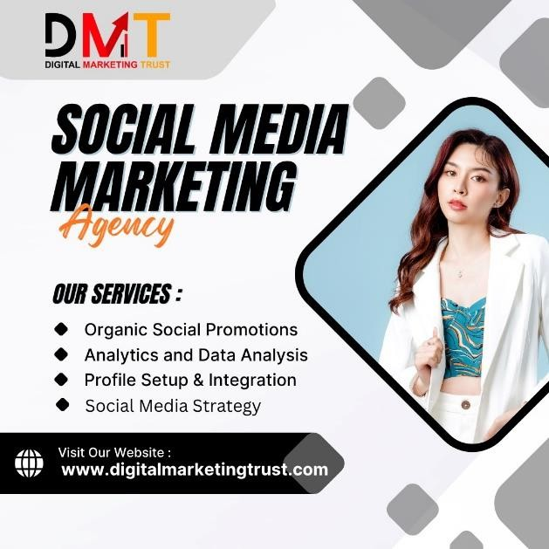
For marketers, it's a versatile and comprehensive tool. Social media helps you engage more directly with your audience and become a more significant part of their lives. It allows you to share product and service updates, event announcements, company and industry news, customer success stories, tips and guidance, and more. The sky's the limit. You can go beyond the sky, depending on your marketing and business goals. Social media reaches every stage of the audience journey. Social media allows you to position your brand and project an up-to-date and highly relevant image. Build customer relationships by sharing information and responding to feedback. Increase website traffic. Get people to sign up for emails, newsletters, and other lead generation content, and even drive purchases.
Furthermore, the stronger your social media influence, the greater your chances of appearing in Google search results.
Social Media Engagement – Listening to Your Customers Successful, lasting brand and customer relationships are no longer just transactional. Instead, they grow over time through a holistic experience spanning transactions, content, and social engagement. Social media engagement software provides businesses with the tools they need to transform these new, ongoing, and constant customer relationships. Monitoring and listening to customers, responding promptly to posts and messages, and staying abreast of industry trends will set you apart from your competitors. More importantly, the ability to automate and schedule posting times, publish at scale to multiple Facebook and Twitter accounts, and transform your business into an agile organization through a single interface is crucial.
By listening to customers through social channels and interpreting relevant signals in real time, you must be able to leverage these signals to stay informedto connect with customers in a valuable and impactful way.

Slide 3
Which social media platforms should my business use?
Social media helps you reach billions of users worldwide at a relatively low cost. Choosing the right platform for your social media marketing campaigns depends on your specific marketing goals and the type of audience you want to reach.
key factor to consider is how your social media presence appears in Google search. To make it easier for potential customers to find you online,

